Slide 1

Crypto Lane
Ali Ali & George Ellis & Szuyuan Cheng

Slide 2
Concept-
。Description
。Motivation for development?
。User story

Slide 3
Description
Notes:
A simple tracking app for cryptocurrency assets.

Slide 4
Motivation for development?
Notes:
Cryptocurrency asset is growing dramatically. Targeting build a tool that let user could have a instant peak of the latest momentum.

Slide 5
User Story
Notes:
We would like to build an app that provides custom information for the latest market flow and price movement.

Slide 6
Process-
。 Technologies used
。 Breakdown of tasks and roles
。 Challenges
。 Successes

Slide 7
Technologies used
Notes:
http://getskeleton.com/ -css framework
https://fonts.google.com/ -80s pixel font
https://fontawesome.com/ -Icons
https://www.coingecko.com/ -Api & widget(price compare & individual scope)
https://codepen.io/ -Background animation

Slide 8
Breakdown of tasks and roles

Slide 9
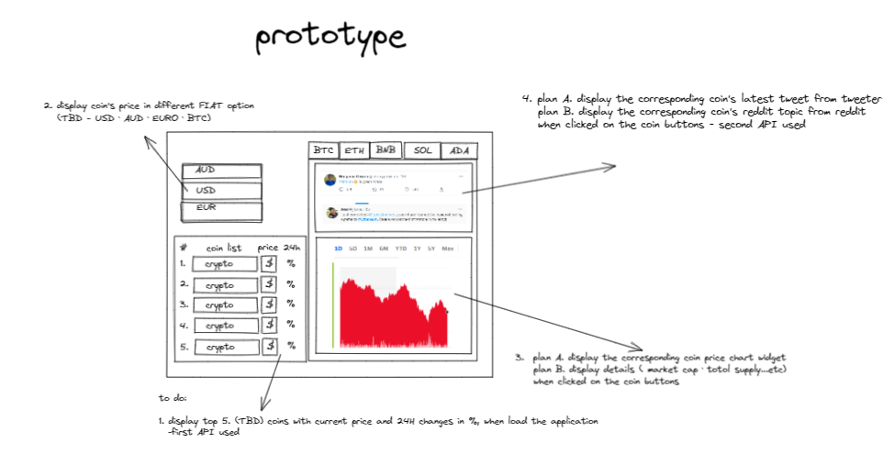

Slide 10
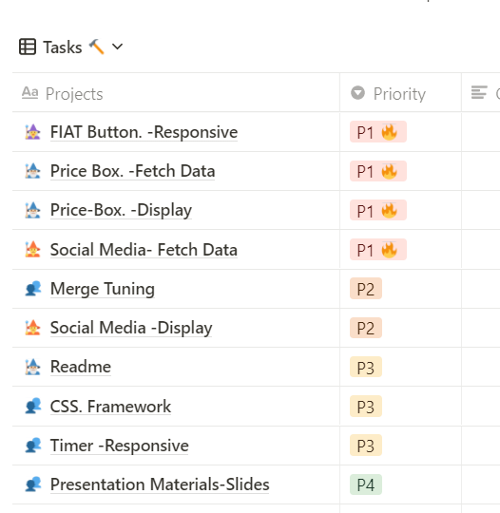
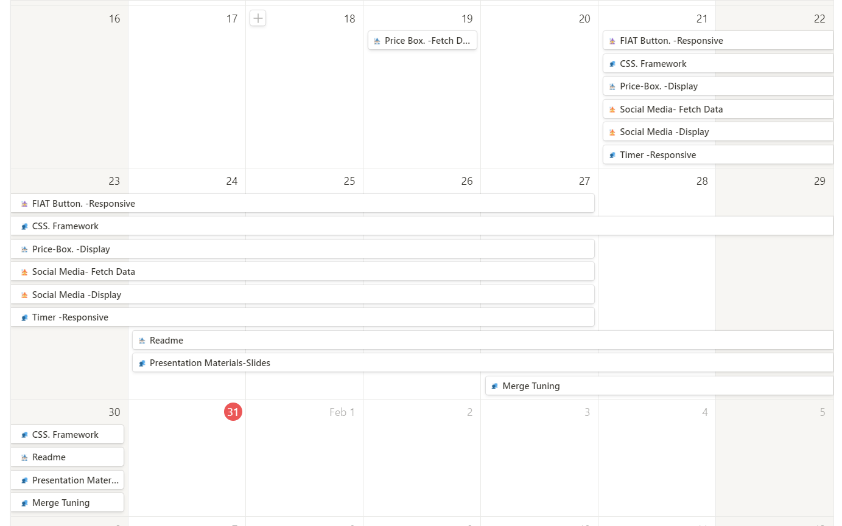

Slide 11
Challenges

Slide 12
Successes

Slide 13
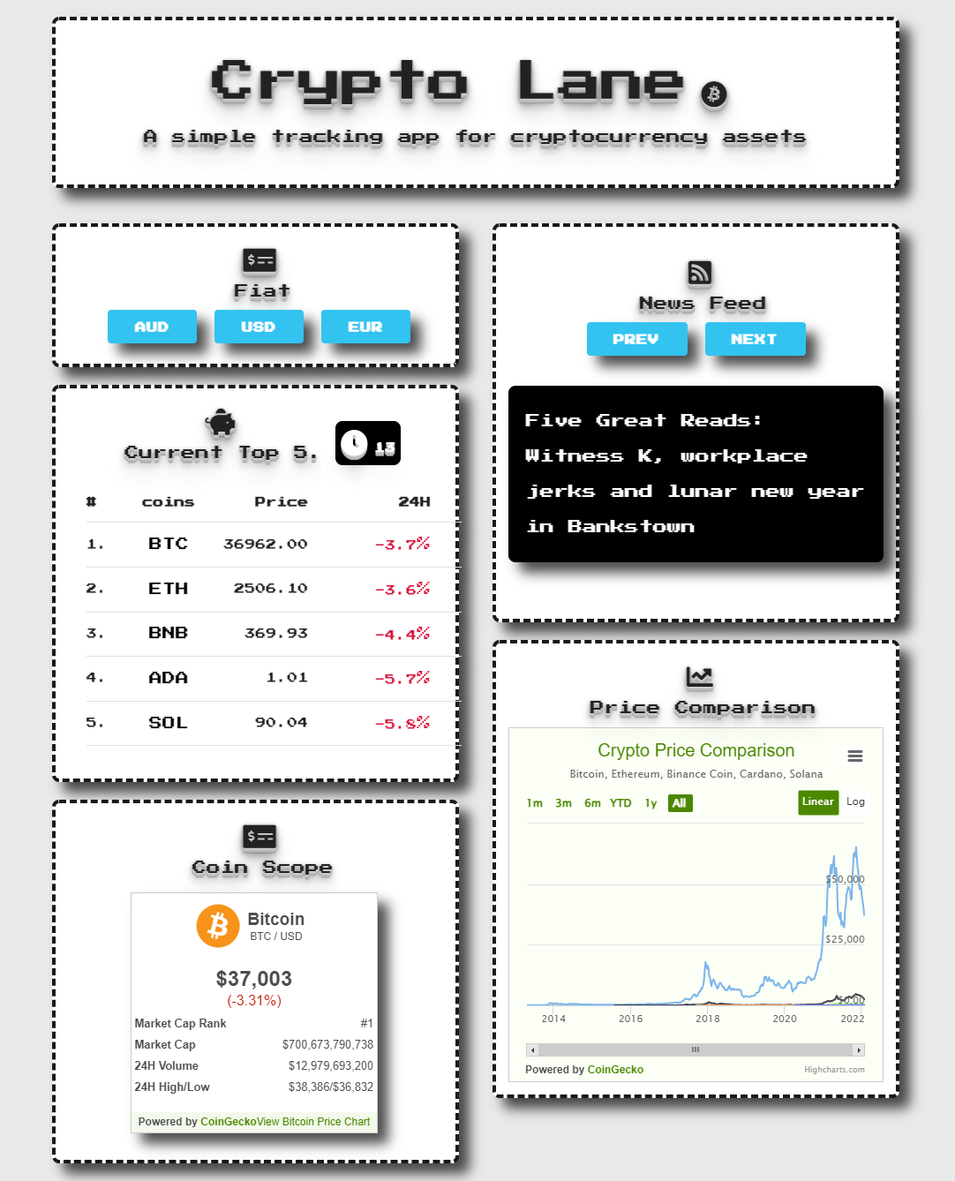
Demo

Slide 14
Initialise

Slide 15
Fiat Button

Slide 16
Social Media-News feed

Slide 17
Price Comparison

Slide 18
Coin Scope

Slide 19
CSS Framwork & Visual effects

Slide 20
Animation effect background

Slide 21
SKELETON

Slide 22
Button clickhover effect & Box shodow effect

Slide 23
Future Scope

Slide 24
Links-
Deployed-
https://opticsl8b.github.io/Project-Crypto-Lane
GitHub repo-
https://github.com/opticsl8b/Project-Crypto-Lane

Slide 25
Questions

